Slide 1



AI-powered Waste Classification System

Slide 2

Learning Objectives
To understand the working of Convolutional Neural Networks (CNNs) for image classification.
To gain knowledge of data preprocessing techniques (resizing, normalization, augmentation).
To train and evaluate a model for waste material classification.
To implement real-time detection using a webcam and Python (OpenCV).
To deploy the model as a Streamlit-based web application.
To apply AI for environmental sustainability through waste segregation.
GOAL
Source :
www.freepik.com/

Slide 3
Tools and Technology used
Programming Language: Python
Libraries/Frameworks:
TensorFlow / Keras → Model training & prediction
OpenCV → Real-time image capture & processing
NumPy → Numerical computations
Streamlit → Web app deployment & UI
Dataset: Custom image dataset (waste categories)
IDE/Editor: VS Code / Jupyter
NotebookHardware: Laptop with Webcam (for real-time detection)

Slide 4
Methodology
Data Collection & Preprocessing
Gathered E-waste and other waste images
Resized, normalized, and augmented dataset
2. Dataset Splitting
Divided into Training (70%), Validation (20%), Testing (10%)
3. Model Development
Built CNN and used MobileNetV2 (Transfer Learning)
Applied Batch Normalization & Dropout to avoid overfitting
4. Model Training & Evaluation
Trained with multiple epochs
Evaluated using accuracy, confusion matrix, classification report
5. Real-Time Prediction
Integrated OpenCV with webcam Predicts waste type instantly
6. Deployment
Built interactive interface using Streamlit
User can classify waste through a simple app

Slide 5
Problem Statement:
Growing E-waste and solid waste pollution is a major environmental concern.
Manual waste segregation is time-consuming, inefficient, and error-prone.
Lack of effective real-time waste classification tools leads to improper recycling and disposal.
There is a need for an AI-based automated system to classify waste accurately and support sustainable waste management.

Slide 6
Solution:
Develop an AI-based waste classification system using Deep Learning (CNN + Transfer Learning).
Train the model on E-waste and other waste categories for accurate recognition.
Integrate with real-time camera (OpenCV) to identify waste instantly.
Provide an interactive Streamlit app for easy use.Helps in efficient segregation, recycling, and reducing environmental pollution.

Slide 7
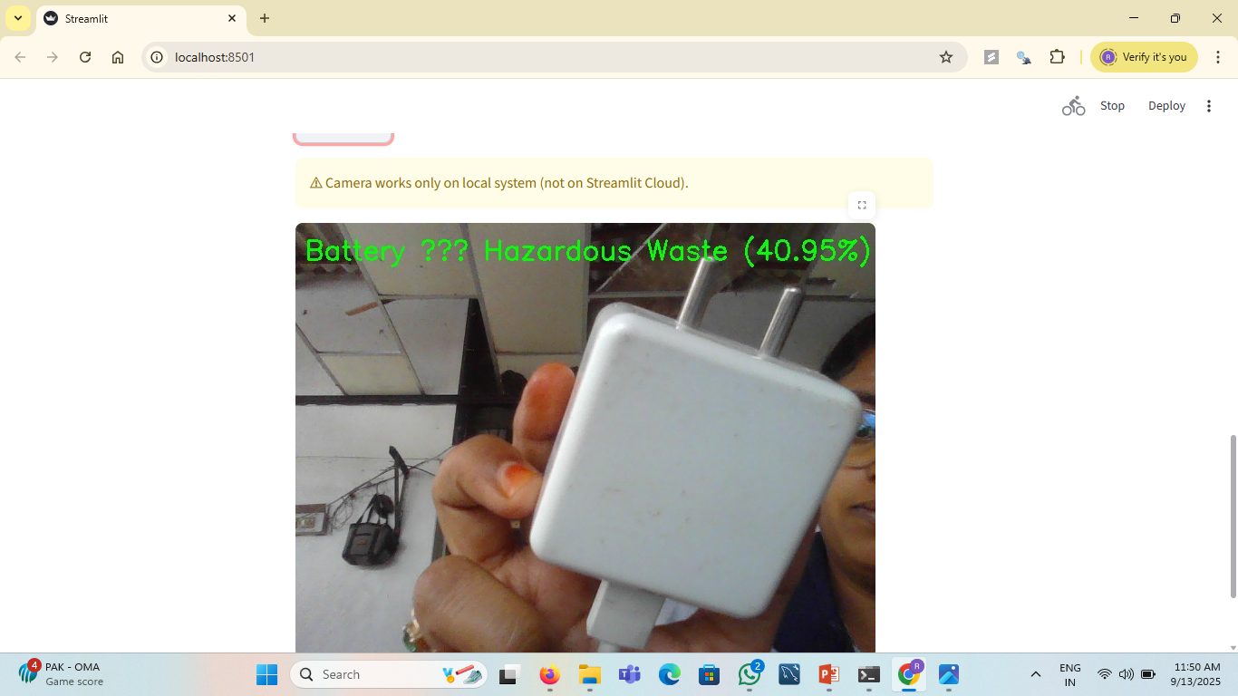
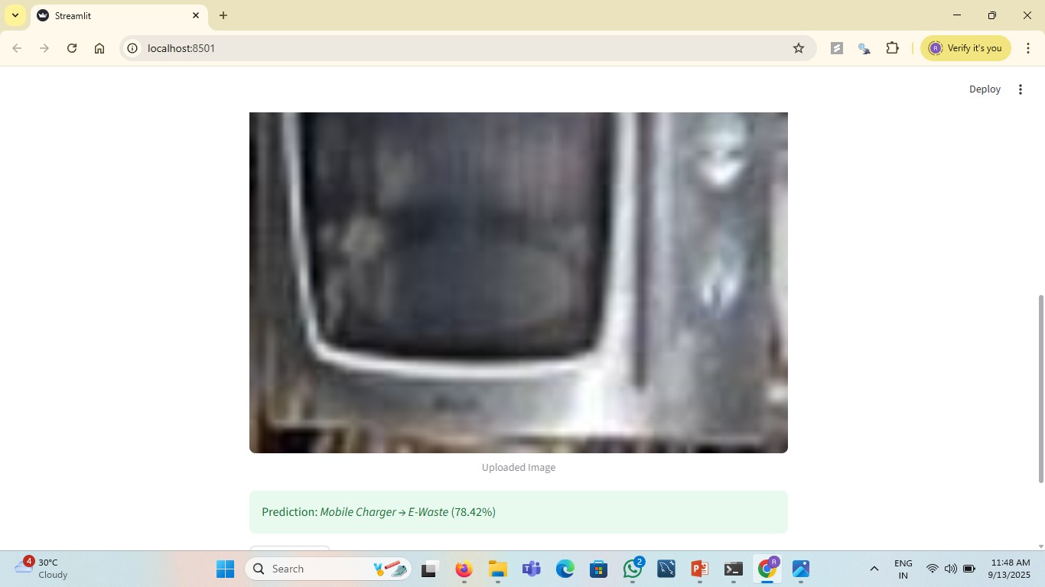
Screenshot of Output:

Slide 8
Conclusion:
An AI-based waste classification system was successfully developed using CNN and Transfer Learning (MobileNetV2).
Achieved high accuracy (~90%+) in classifying different waste categories.
Integrated with real-time camera detection for instant identification.
Helps in automating waste segregation, improving recycling efficiency, and reducing environmental pollution.
The project demonstrates how AI & ML can contribute to sustainable waste management.

